Slide 1

12: Fuzzy Logic, probability and inference
COMP702: Classical Artificial Intelligence

Slide 2
Fuzzy Logic
Boolean logic: variables are either true or false
Humans don’t tend to reason with hard Boolean logic – we use information that is vague, imprecise and uncertain
Fuzzy logic was introduced in 1960s to model this
Variables have a truth value between 0 and 1
Related to fuzzy set theory: instead of elements being either in or not in a set, they have a degree of membership between 0 and 1

Slide 3
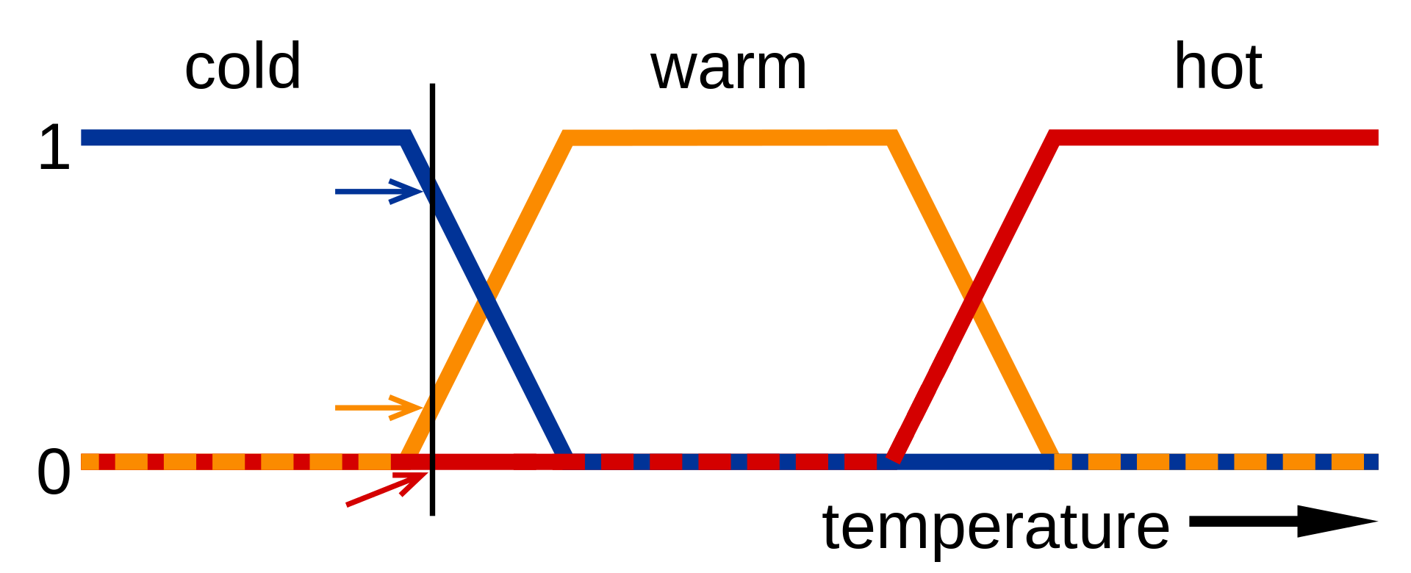
Fuzzy logic example
“It is cold”, “it is warm”, “it is hot” are fuzzy statements

Slide 4
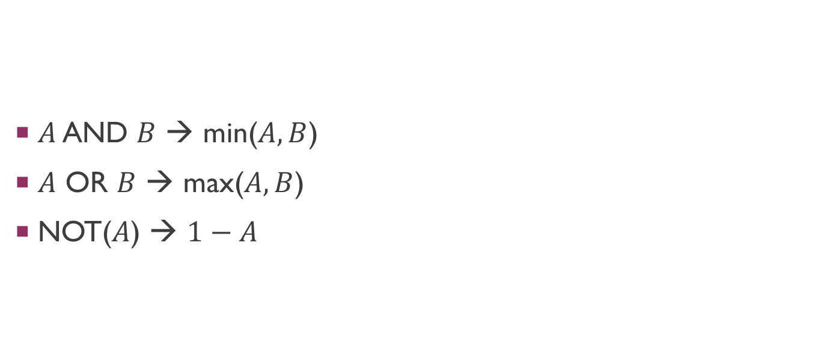
Fuzzy Logical operators
$A$ AND $B$ → min($A, B$)
$A$ OR $B$ → max($A, B$)
NOT($A$) → $1−A$

Slide 5
Probability
Similar to fuzzy logic: values between 0 and 1
Fuzzy logic models vagueness
Probability models likelihood

Slide 6
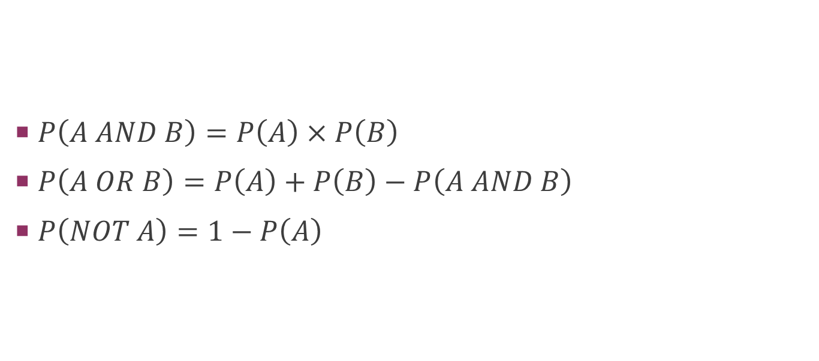
Probability “logic”
$P\left(A AND B\right)=P\left(A\right)×P\left(B\right)$
$P\left(A OR B\right)=P\left(A\right)+P\left(B\right)−P\left(A AND B\right)$
$P\left(NOT A\right)=1−P\left(A\right)$

Slide 7
bELIEFS
Recall: in a game of imperfect information, the state of the world is not known
The information set is the set of all possible states
Some states are more likely than others
The agent’s beliefs can be modelled as a probability distribution over the information set
A function assigning a probability to each state
Probabilities add up to 1

Slide 8
Inference
The agent’s beliefs may change based on observing the game
In particular, based on what actions other players choose
E.g. in Poker, inferring what cards other players are likely to have based on their choices of bids

Slide 9
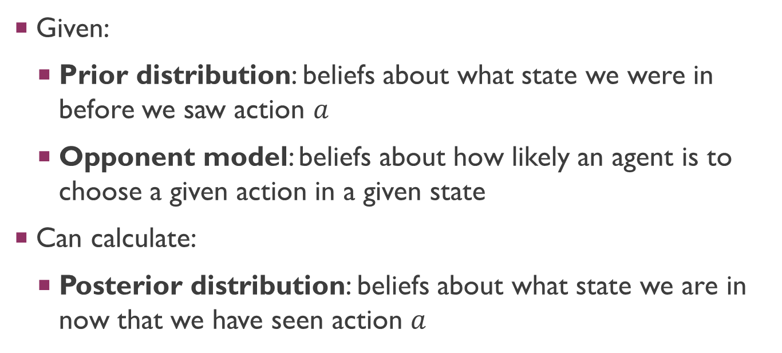
Bayesian inference
Given:
Prior distribution: beliefs about what state we were in before we saw action $a$
Opponent model: beliefs about how likely an agent is to choose a given action in a given state
Can calculate:
Posterior distribution: beliefs about what state we are in now that we have seen action $a$

Slide 10
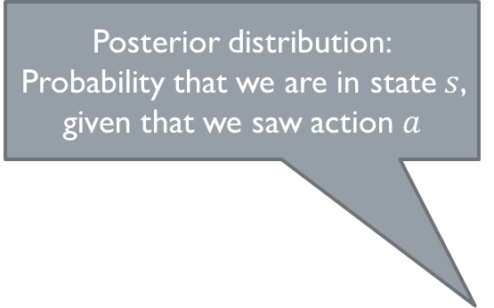
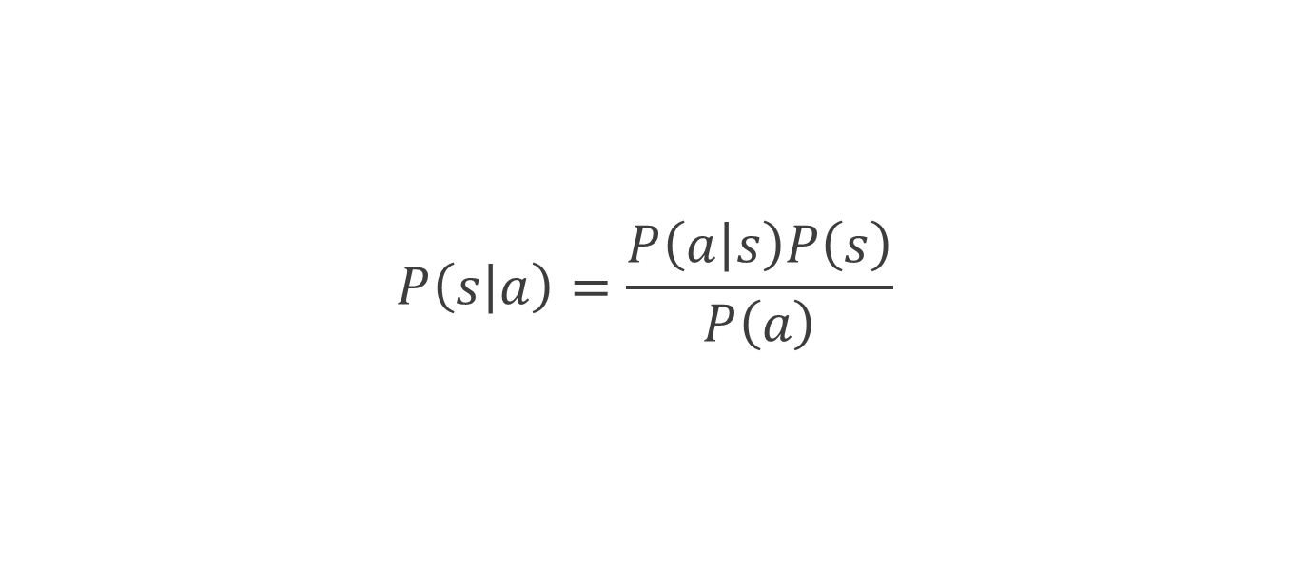
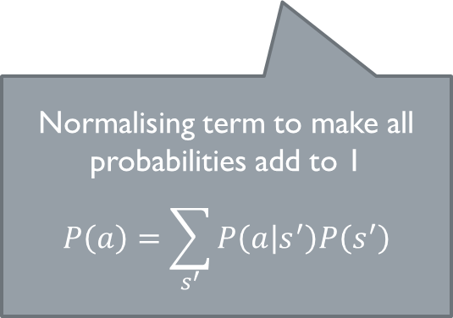

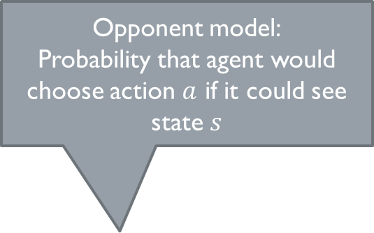
Bayesian inference
Opponent model:
Probability that agent would choose action $a$ if it could see state $s$
Posterior distribution:
Probability that we are in state $s$, given that we saw action $a$
$$P\left(s | a\right)=\frac{P\left(a | s\right)P\left(s\right)}{P\left(a\right)}$$
Prior distribution:
Probability that we were in state $s$
Normalising term to make all probabilities add to 1
$$P\left(a\right)=\sum_{s^{′}}{P\left(a | s^{′}\right)P\left(s^{′}\right)}$$

Slide 11
Bluffing
Bayesian inference relies on an opponent model
Assumption of rationality
However, if a rational agent knows that they are being observed and inferred upon, this might influence their behaviour…
Bluffing refers to any behaviour deliberately meant to fool inference

Slide 12
Emergent bluffing and inference with Monte Carlo Tree Search
Peter Cowling, Daniel Whitehouse, Edward J. Powley. Proceedings of IEEE Conference on Computational Intelligence in Games, 2015.
Notes:
Numbers in [square brackets] correspond to steps in the “custom animation” panel

Slide 13
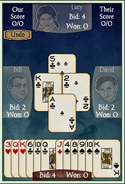
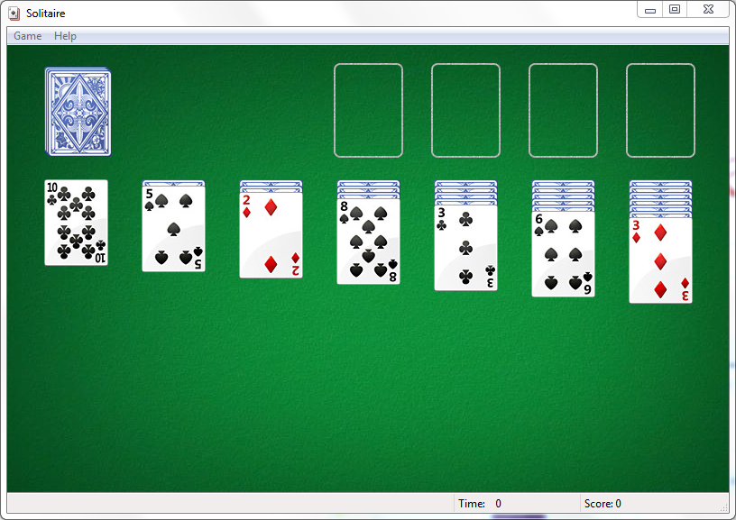
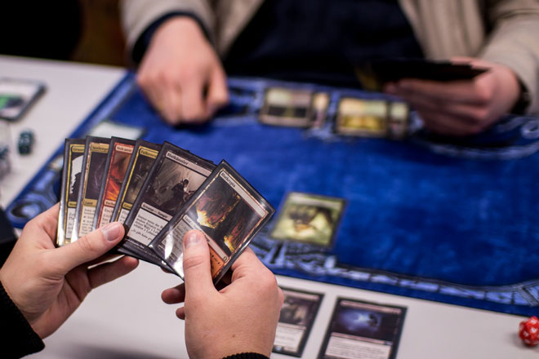
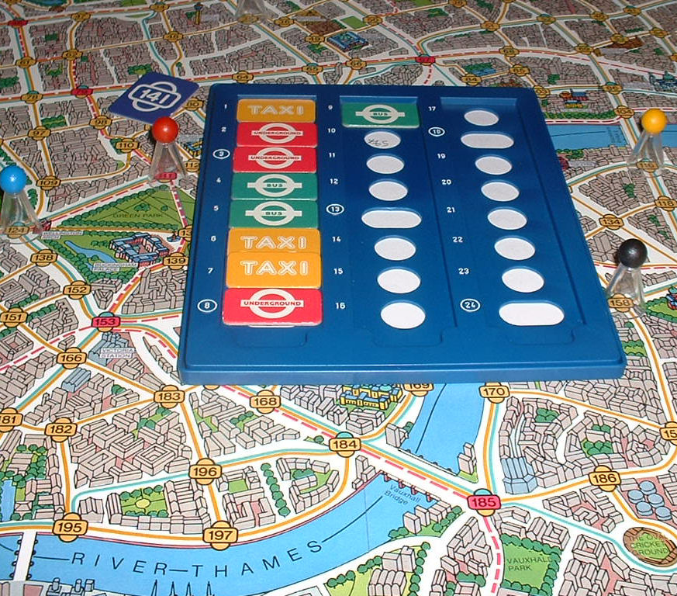
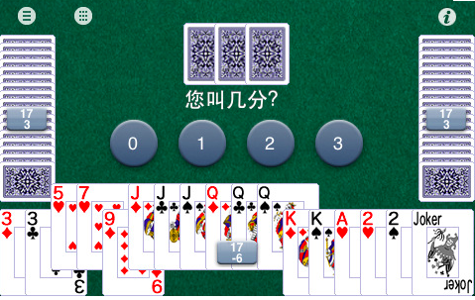
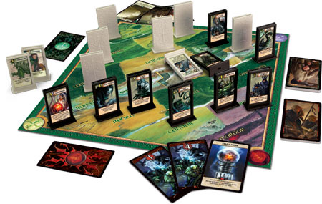
Motivation
Many interesting games have imperfect information
MCTS has successfully been applied to several such games
MCTS is robust in the face of uncertainty, but bad at information gathering and/or hiding
Notes:
[1] Imperfect information means players cannot see the entire state of the game, and/or cannot see each other’s moves. Observations are usually asymmetric, ie different players can see different parts of the state.
Games (left column): Klondike Solitaire (Bjarnason et al), Magic The Gathering (Ward et al), Dou Di Zhu (Cowling, Powley and Whitehouse)
Games (right column): AI Factory Spades (Cowling, Powley and Whitehouse), Scotland Yard (Winands et al), LOTR: The Confrontation (Cowling, Powley and Whitehouse)
[3] “Robust in the face of uncertainty”: most MCTS approaches are optimising for the average case
MCTS approaches generally fail to exploit the fact that the opponent has imperfect information: they tend to assume that if I can see a thing, then my opponent can see it too

Slide 14
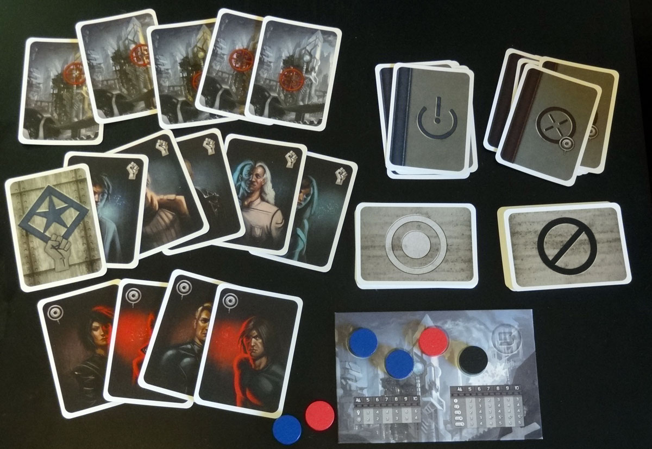
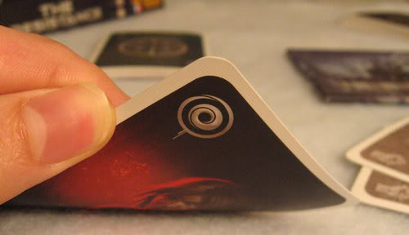
The Resistance
Every player is either a resistance fighter or an imperial spy
Spies know who the other spies are, resistance don’t
Resistance need to infer who the spies are, and spies need to bluff to appear un-spy-like
Resistance don’t need to bluff, and spies don’t need to infer
Notes:
For simplicity, we only consider the 5-player version of the game: 3 resistance and 2 spies
[3] Resistance do not need to bluff (it is never beneficial for a resistance player to appear spy-like) and spies do not need to infer (they already have perfect information) – this makes the game a good testbed for studying these techniques in isolation, as most games require both skills at once

Slide 15




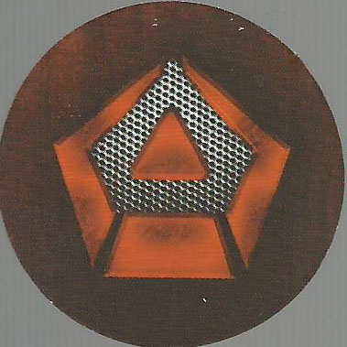

The Resistance
Someone chooses a team
Everyone votes (publicly, simultaneously)
If a majority approves, the team goes on a mission
Spies can choose to sabotage (secretly)
If anyone sabotaged, score 1 for the spies
If not, score 1 for the resistance
First team to score 3 wins
Notes:
Emphasise that votes are public (ie individual players’ votes are revealed) but mission choices aren’t (the identity of a saboteur is not revealed)
This demonstrates the “hidden moves” aspect of imperfect info: mission choices are hidden moves
Votes are also hidden moves, but the hidden info is short-lived: it gets revealed soon after

Slide 16


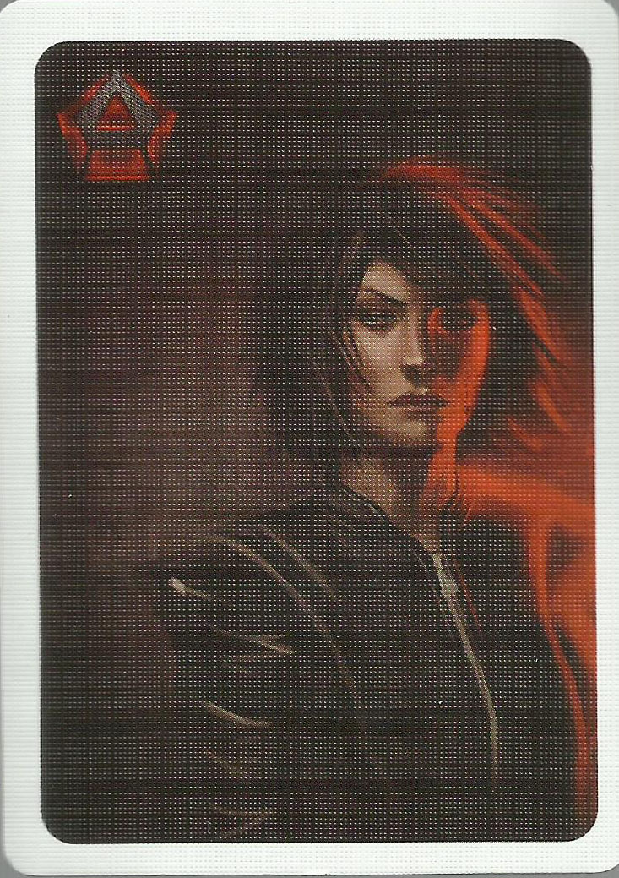


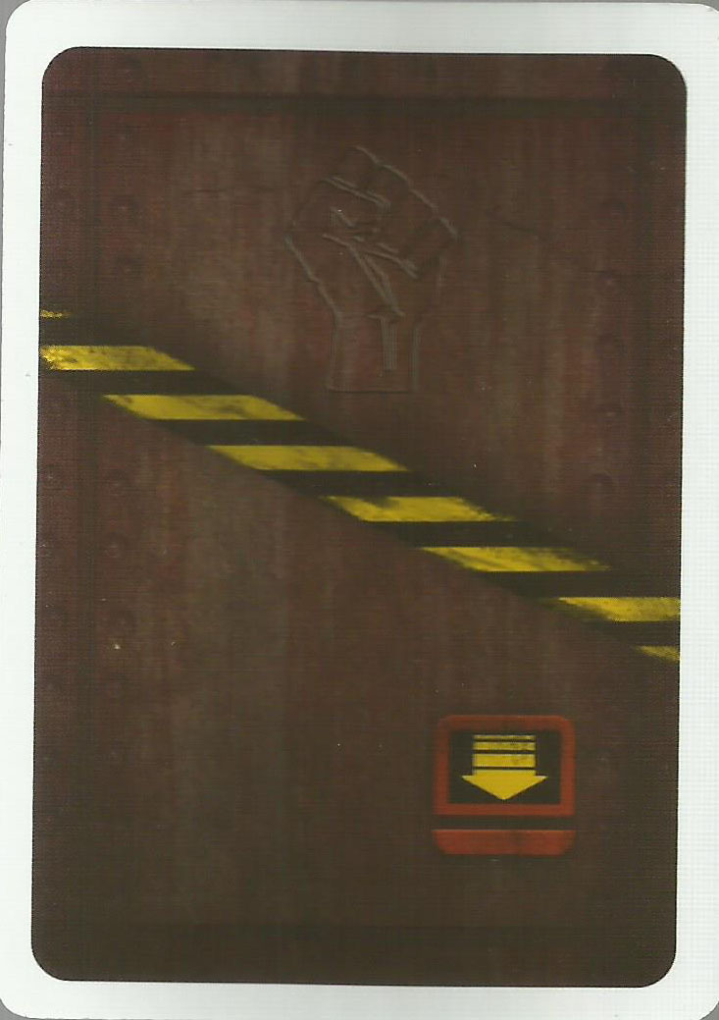
Information sets
Observation gives a set of possible states, one of which is the actual state of the game
Information set:
{
,
Actual state:
,
,
,
Observation:
}
,
Notes:
From what a player can see, he could write down a list of all possible game states (but of course he couldn’t know which one is the actual state)
[1] Actual state: everyone has a role
[2] Observation: everyone’s role is hidden except mine
[3] Information set: every possible assignment of roles to the other players, given that there are two spies and I’m not one of them
Information sets in The Resistance have only 6 elements; in most games the information sets are combinatorially large

Slide 17

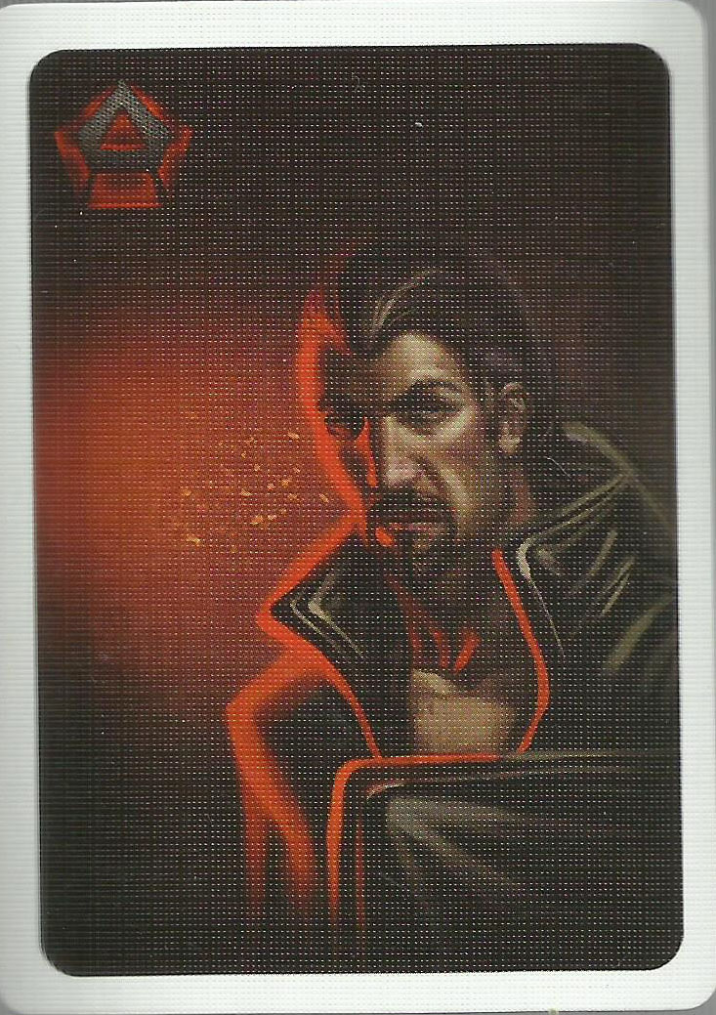
Information sets
Spies have perfect information, so the information set is a singleton
Information set:
{
}
Actual state:
Observation:
Notes:
Spies are in the special position that they can see everything, so their information sets have only one element

Slide 18

Information Set MCTS (ISMCTS)
Each iteration samples a determinization (a state from the current information set)…
… and performs the playout as if that determinization was the true root state
P. I. Cowling, E. J. Powley, D. Whitehouse. Information Set Monte Carlo Tree Search. IEEE Transactions on Computational Intelligence and AI in Games, 4(2):120-143, 2012.
Notes:
Vanilla MCTS works by running several thousand playouts, at first with random moves to the end of the game
The results of those playouts are used to build a tree of win/loss statistics, which is used to influence subsequent playouts
[1,2] ISMCTS works the same, except that each playout is done with respect to a sampled determinization
All the playouts still read and write the same tree though, so in a sense that tree is averaged over all determinizations

Slide 19

Multiple trees in ISMCTS
This tree doesn’t capture the notion of hidden moves
We need to consider separate trees from each player’s point of view
Each playout descends all trees in parallel to keep track of the players’ differing viewpoints
Notes:
[1] Suppose that \/ is trying to decide how to vote. In the top tree, \/ has two decision nodes, one for each way /\ might have voted.
This means \/ can vote differently depending on how /\ voted.
However, votes are hidden -- \/ shouldn’t be able to see how /\ voted, and certainly shouldn’t be able to base his decision on that information!
[2] So we need separate trees
In the bottom right tree, there is only one decision node for \/, following from the branch where /\ does a hidden vote
Similarly, /\ has a tree where his vote is followed in each case by a hidden vote from \/
[3] How does this fit into ISMCTS?
We still do playouts, each with a sampled determinization
However, we now have a separate tree for each player
As the playout proceeds, it descends the trees depending on what each player would observe during that playout (green arrows on the pictures)
Moves in the playout are chosen according to the corresponding player’s trees, ensuring that the playout moves properly model the moving player’s (lack of) information at that point in the playout

Slide 20
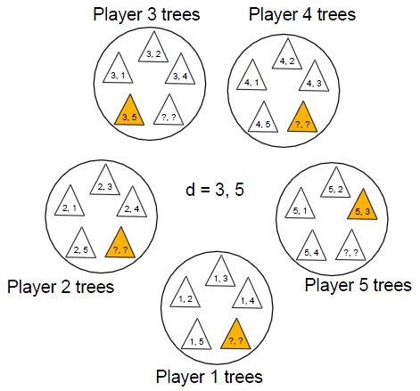
Multiple trees in ISMCTS
Each player has multiple trees, to model their observations of different determinizations
In this tree, player 4 is resistance and doesn’t know who the spies are
In this tree, player 5 knows that players 3 and 5 are spies
Determinization: “players 3 and 5 are spies”
Notes:
The stuff on the previous slide is all very well for hidden moves, but we still need to account for the difference in information at the beginning of the playout
The sampled determinization selects the trees to be used for this playout
(If someone asks how this differs from Perfect Information Monte Carlo: in PIMC, there is one tree per determinization; in ISMCTS, different determinizations update a single tree. Thus ISMCTS has sharing of information between trees, whereas PIMC has none.)

Slide 21
Particle filter inference
Some determinizations reach some parts of the tree more than others
By keeping track of this, hidden information can be inferred from observed actions
Sampled frequencies are used to update the sampling distribution for determinizations for future decisions
Notes:
[0] So far, we’ve sidestepped the question of how determinizations are sampled
If the player believes some determinizations to be more likely than others, this should be reflected in the sampling
At the start of the game, all states are equally likely (the deck of role cards is shuffled)
But what about subsequently?
[1, 2] If we just watch the determinizations as they trickle through the tree, we will see that some reach certain parts of the tree more than others – this is because the playout is being influenced by the other trees
See next slide for an example...

Slide 22
Particle filter inference
“If ∇ were resistance, he would probably choose move A”
“If ∇ were a spy, he would probably choose move B”
= resistance
= spy
Depending which move is observed in the actual game, carry the corresponding distribution forward as the new sampling distribution for determinizations
Opponent trees
Move A
150 visits
Team 4,5
50 visits
Team 1,2
50 visits
Move B
150 visits
...
...
“Therefore if ∇ chooses move B, he is probably a spy”
Move A
200 visits
75% resistance, 25% spy
Move B
200 visits
25% resistance, 75% spy
My tree
...
Notes:
[0] Here we have two ISMCTS trees for \/: one where he is resistance, one where he is a spy. We can see that he favoured move A when he was resistance, and move B when he was a spy
[1] Here’s my tree: I don’t know whether \/ is a spy, so I sampled both determinizations and my tree has averaged results. Here I see an equal number of playouts for both moves. However note how often each determinization went down each branch.
[2,3,4] As a human player, here’s the reasoning I’d be doing in my head
[5] So if in the actual game we see \/ do move B, we should update the sampling distribution accordingly

Slide 23
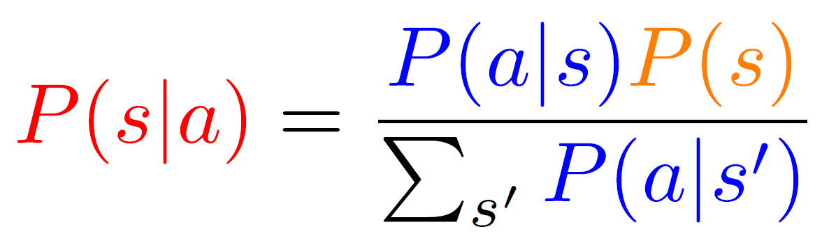
Particle filter inference
Bayesian inference usually requires an opponent model
MCTS implicitly generates an opponent model
Particle filter inference uses this model to perform inference
Particle filter inference estimates P(s|a) from the MCTS playouts – no need to go through Bayes’ rule
Opponent model
Prior distribution
Posterior distribution
Opponent model
Notes:
[1] The equation is only there for illustration, don’t bother explaining it
[2] In fact, all tree search implicitly generates an opponent model – that’s kind of the definition of tree search, and goes back to von Neumann’s Minimax Theorem
[3] We’re reusing the opponent model we already have. Eco-friendly!
[4] The determinizations trickling through the opponent model are essentially a sampling approximation to Bayes

Slide 24
Results
5 ISMCTS players, each using 20000 iterations (approx 0.2 seconds) per decision
Without inference, resistance win 28.3% of games
When resistance use particle filter inference, resistance win 94.7% of games
With vanilla MCTS, both sides are stupid
Spies are blatant, but resistance don’t notice
Inference massively changes the balance of the game – spies can’t afford to be blatant any more
Notes:
[2,3] Particle filter inference increases resistance’s win rate by 66.4% -- clearly a massive gain

Slide 25
Bluffing
Suppose I am a spy…
To accurately model what other players are thinking, I need to bear in mind that they don’t know I’m a spy
Basic ISMCTS samples determinizations from the current information set
If I know I’m a spy, then 100% of the determinizations I sample have me as a spy
Essentially I am assuming that everyone knows I’m a spy!
To solve this, ISMCTS needs to self-determinize
Sample determinizations where I am not a spy, and allow those determinizations to influence the opponent trees
Notes:
[0] What can the spies do to counteract the massive benefit of particle filter inference? They need to be less blatantly spy-like, ie to bluff
[1,2] As a human, this would be my thought process
[3,4] Recall that spy info sets are singletons (slide 7) – sampling from a singleton always gives the same answer
[5] If I think everyone knows I’m a spy, then I don’t even consider the option of doing something non-spy-like
[6] Up to now, determinization always samples from the current information set – need to change this to sample from outside the information set
That is, need to sample determinizations which we know are impossible, but where opponents don’t know that

Slide 26
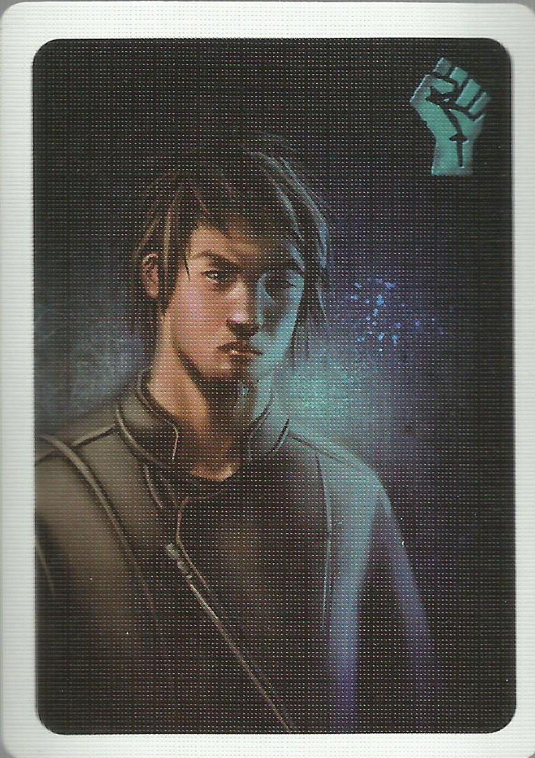
Bluffing
Multi-tree ISMCTS can already handle self-determinization without polluting the tree used for the final decision
Tree corresponding to actual situation – used for final decision
1, 3
1, 2
1, 4
1, 5
?, ?
Trees corresponding to other situations – used to model “what I would do if...”
Notes:
Searching impossible determinizations is dangerous if it makes me do things I should know are stupid
[3] This is the key point: these other trees aren’t used for the final decision
They’re just there for “meta-modelling”: making the opponent model more accurate by considering the opponent’s model of me

Slide 27
Bluffing
Every ISMCTS iteration that self-determinizes is an iteration not spent considering the true world state
Only a fraction of MCTS iterations contribute to the final visit counts used to select a move; the rest are spent refining the opponent model
We also tried turning off self-determinizations partway through the search
Increases the fraction of iterations used for move selection
Notes:
[1] Self-determinization also introduces an efficiency issue – we now need to trade-off between time spent meta-modelling and time spent actually trying to decide which move to play in the real game
[2] This is a way of tuning that trade-off

Slide 28
Bluff mixing
Choose the most visited move as normal
Pick out the moves with average reward within 1 std. dev. of the most visited
Amongst those moves, choose the most visited across all self-det trees
If several good moves are available, choose the one that looks the best in the average case
However, don’t play a bad move for the sake of bluffing: if there is only one good move then play it
Notes:
[0] Self-determinzation should be sufficient for bluffing to emerge, eventually – we also tried a mechanism to encourage bluffing behaviour explicitly
[1] Just like in vanilla MCTS and vanilla ISMCTS
[2] Choose the moves that aren’t significantly worse than the “best” move
[3] Sum visit counts across all trees, and choose the most visited restricted to the subset of “OK” moves
[4,5] Just reiterating the above

Slide 29
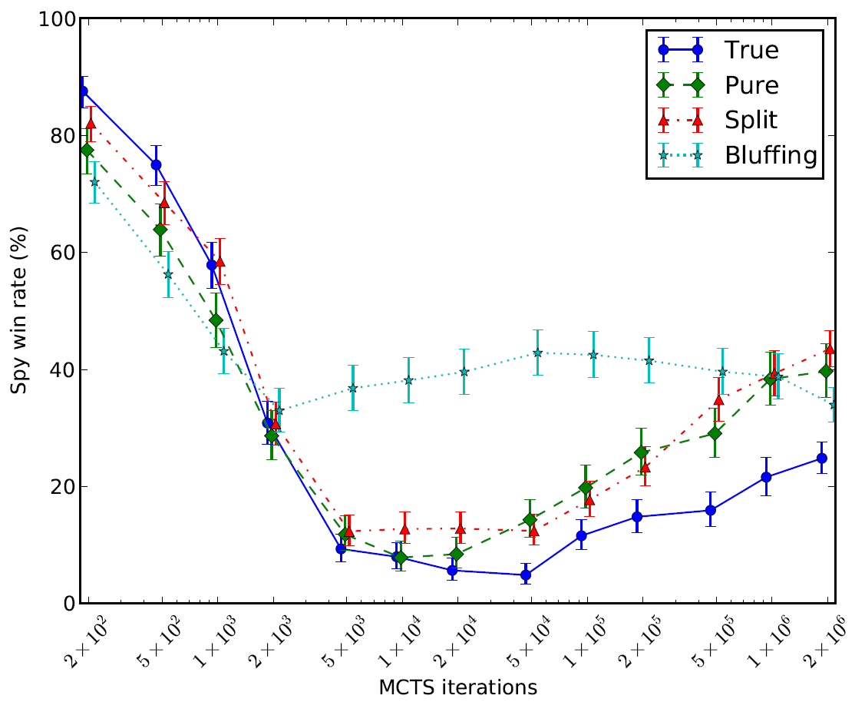
Results
5 ISMCTS players, all use specified iterations per decision
Resistance use particle filter inference
No self-det
All self-det
Half self-det
Bluff mix
Bluff mixing is helpful for intermediate numbers of iterations
Self-det improves at large numbers of iterations
→ Emergent bluffing
Particle filter inference is weak for small numbers of iterations
2×10⁴ → 0.2 seconds & 20MB memory per decision
2×10⁶ → 20 seconds & 2GB memory per decision
Notes:
[1] Note the logarithmic scale on the x-axis
CPU time and memory scale linearly with number of playouts – in particular, if we were making a commercial product, 10^4 would be realistic but 10^6 would be impractical
[2,3,4] These are the key points to make about this graph

Slide 30
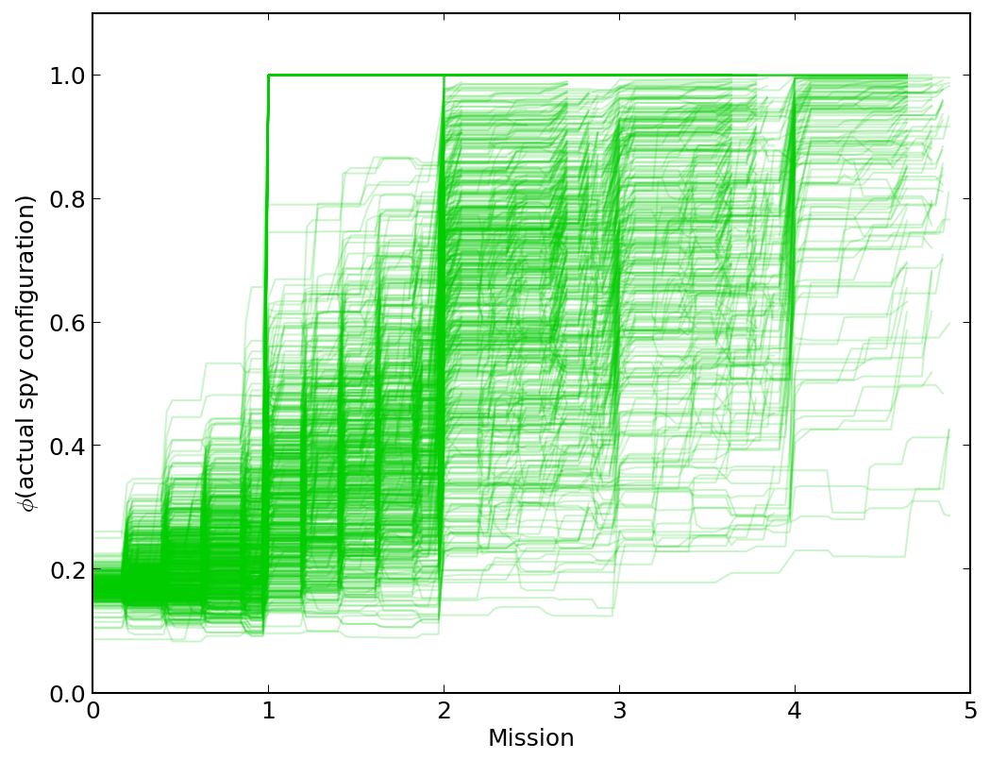
Explanation of the pictures you’re about to see...
Probability inferred for the actual game state
Each line = 1 game
Time
Notes:
We also looked at how the inferred probability distributions change over the course of the game
[1] Higher is better. Anything below 1/6 = 0.1666 means the wrong thing is being inferred, ie the inference engine is assigning less than an even probability to the actual state
[2] Normalised over the 5 rounds – you can see the small steps after votes, and the larger steps at the ends of rounds, as times where inferences tend to be made

Slide 31
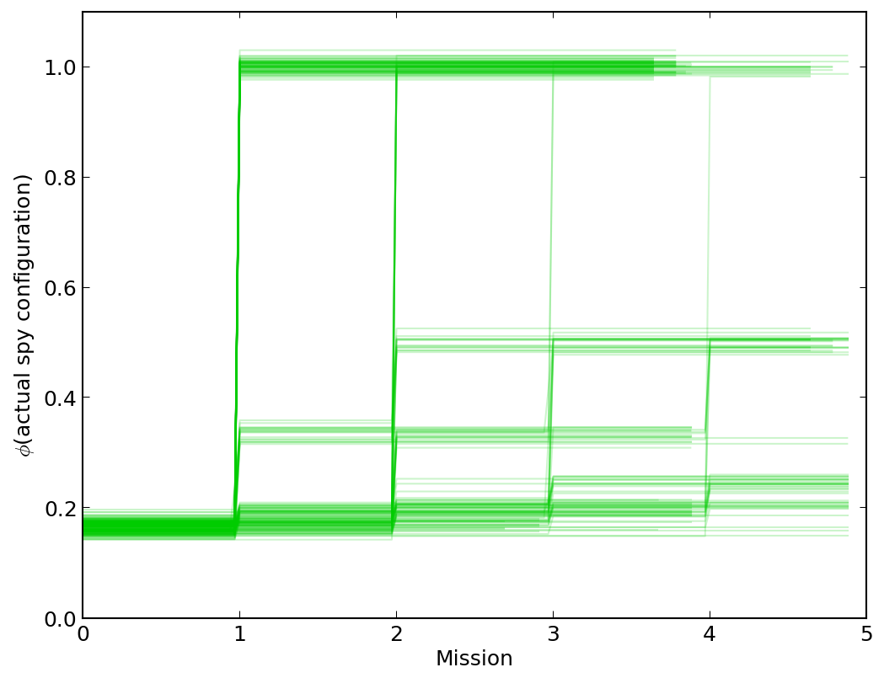
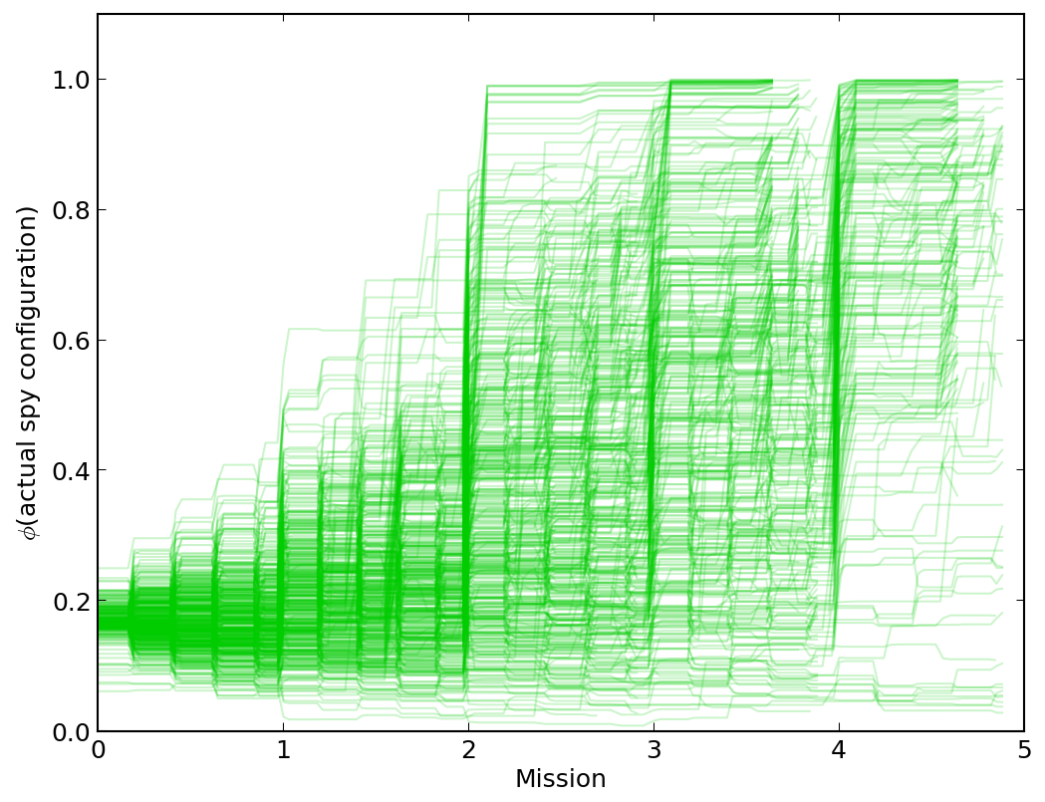
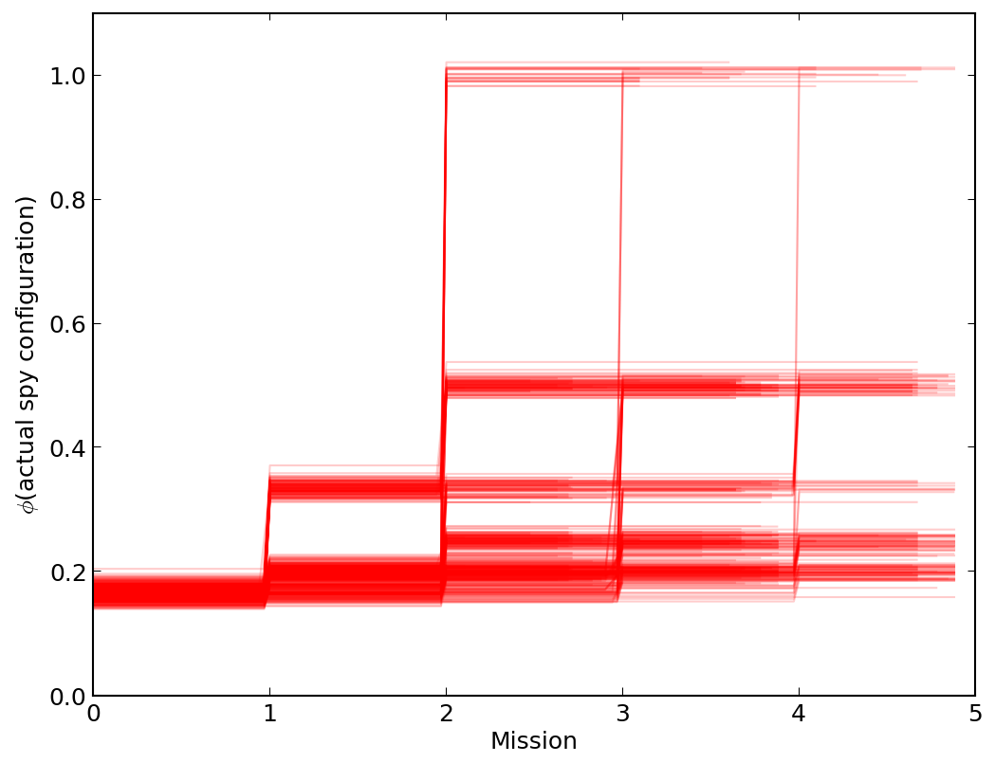
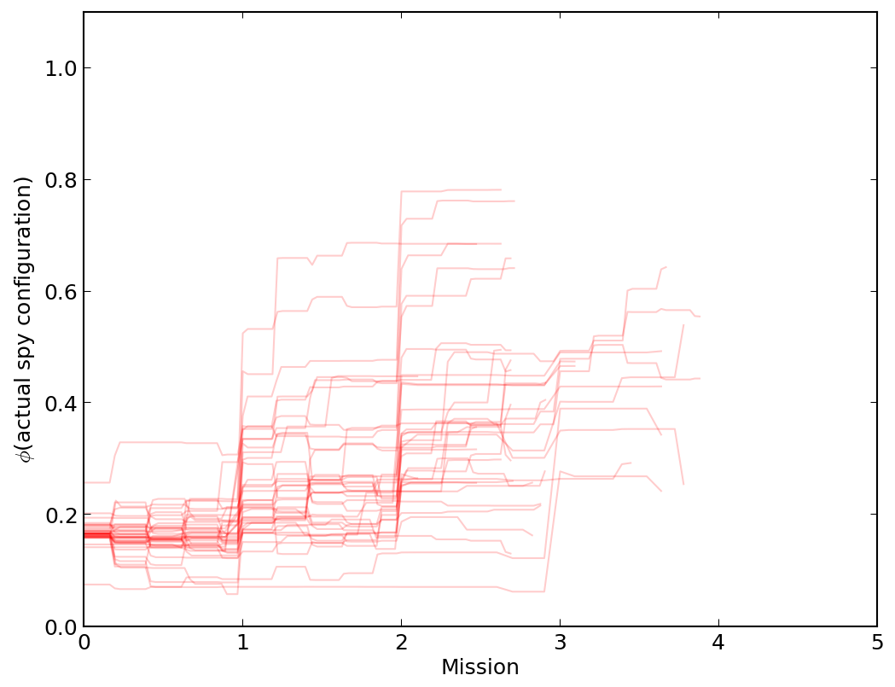
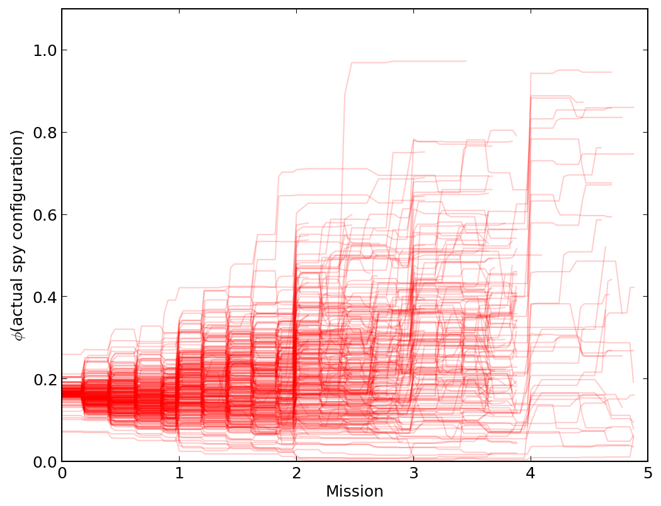
Results
Resistance: no inference
Spies: no self-det
Resistance: PF inference
Spies: no self-det
Resistance: PF inference
Spies: bluff mixing
Spies are usually known by the end of the game
Resistance win
All information revealed by hard constraints
Shallower upward trend
Spies win
Correlation between losing the game and failing to identify spies
Notes:
[1] Hard constraints: a sabotaged mission must contain at least one spy, a double-sabotaged mission reveals both spies
Hard constraints are the only way for a no-inference player to change its sampling distribution
[4] The lines down here (games where the spies won) have a less steep upward gradient than the ones above (games where the resistance won)
[6] Shallower upward trend shows that bluffing is making inference less accurate
Many more of the lines are dipping below that 1/6 threshold as well
(Resistance sometimes still manage to win despite making incorrect inferences -- maybe through luck, maybe through managing to identify one of the spies but not the other)

Slide 32
Other games?
Information sets in The Resistance are small enough to enumerate (≤6 states)
This is not true of many other games
E.g. in Contract Bridge, information set size is ³⁹C₁₃ × ²⁶C₁₃ ≈ 8.4×10¹⁶
Extending to other games will require more work
State abstraction and bucketing
Particle reinvigoration
Notes:
[3] Abstraction and bucketing: can’t keep track of 10^16 trees, so need to group determinizations into the same bucket, and have a tree per bucket instead of a tree per opponent info set
Particle reinvigoration: the chances are small of the actual state being in the initial batch of sampled determinizations, so we need to give particle filter inference the chance to re-sample it once the space of possibilities has been narrowed down a bit

Slide 33
Conclusion
ISMCTS shows great promise for games of imperfect information
ISMCTS can perform inference almost for free, reusing the opponent model it already generates
Bluffing can emerge from ISMCTS, or can be introduced artificially for smaller CPU budgets
Notes:
[1] (Not really a conclusion of this talk, but Peter made me put it in)
[2] For The Resistance, inference is massively beneficial (66.4% increase in win rate)
[3] Bluffing is an effective countermeasure for inference: when resistance use inference and spies bluff, the game is about as balanced as it is with human players

